Slide 1

PNS Mid Year AOP: FY 2022-2023

Slide 2

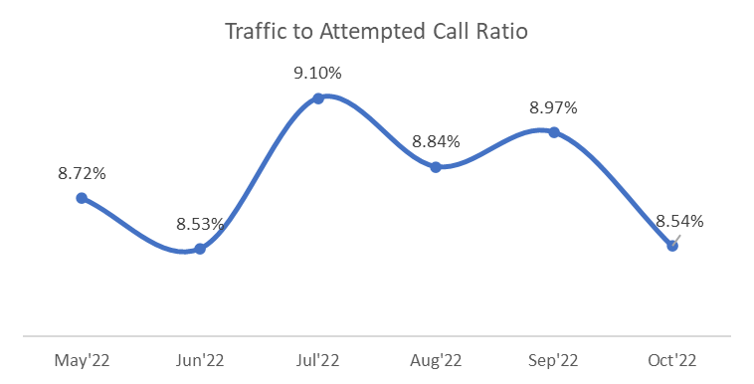
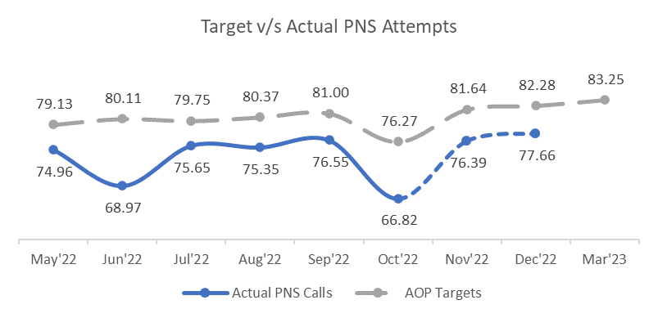
PNS Attempted Calls- Target v/s Achieved
All fig in Lacs
Note: Multiple external factors (change in Google SEO Algo, Returning of 2.2 Knowlarity numbers, Airtel Server crashed) are responsible for dip in Jun’22

Slide 3
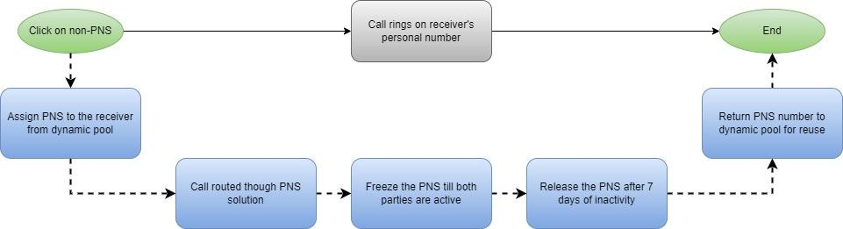
Increase PNS call clicks: Dynamic PNS
Expected Impact: ~2.8 Lacs per month non-PNS call clicks

Slide 4
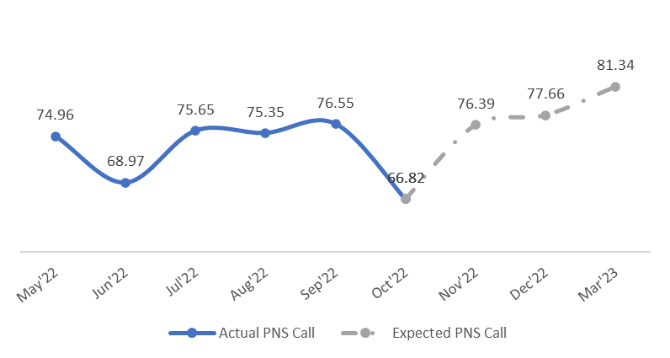
Increase PNS Attempts
Expected numbers are based on Mar’22 session
All fig in Lacs

Slide 5

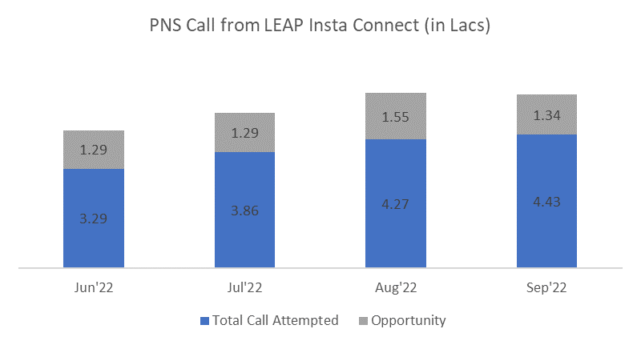
Increase PNS Attempts
PNS Call Enquiry 1.3L/Month
Fix leakages in LEAP oncall connect process
All fig in Lacs

Slide 6
Increase PNS Attempts:
Insta connect on TTS approved leads
Initiate instant PNS call upon buyer acknowledgment on TTS approved leads
2.6 Lakhs Approved Leads
~92K Connected calls
~74K Monthly PNS calls
Ask Buyer on IVR for Instant connect with Supplier once the lead gets approved
~40% of the buyer agree to connect instantly with the supplier
~80% of the initiated calls were connected through PNS (Telco network challenges)

Slide 7
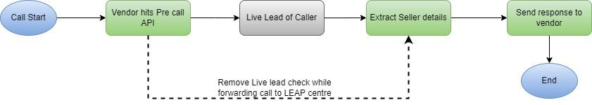
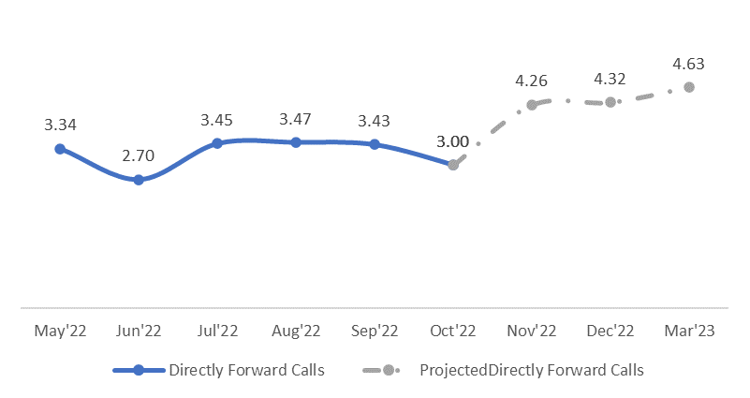
Enhance Buyer Experience
PNS Call flow logic
All fig in Lacs
Direct forward Calls 93K/Month

Slide 8
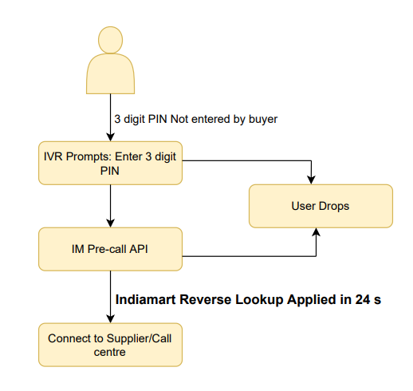
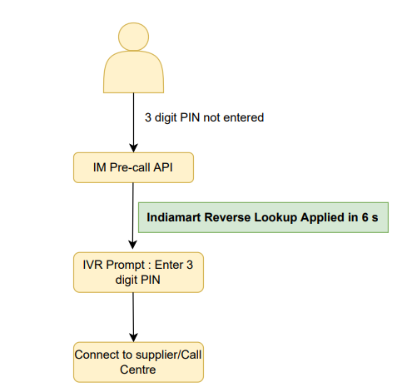
Reduce call drop before pre-call API trigger
Old Extension call flow
Proposed Extension call flow
Increased applicable Calls (Reverse Lookup logic upfront)
Reduction in call drops (buyer-Supplier/Call centre connect earlier)

Slide 9
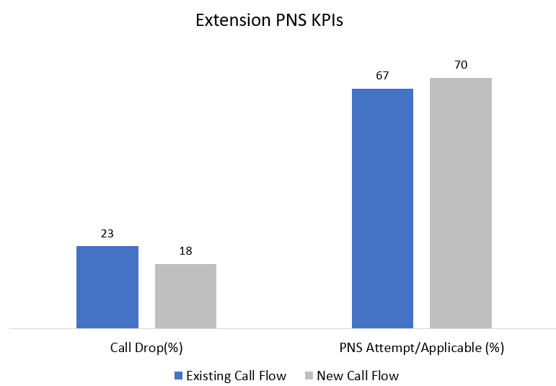

Reduce call drop before pre-call API trigger
Optimisation of Extension call flow
PNS Applicable Calls - 30K/Month

Slide 10
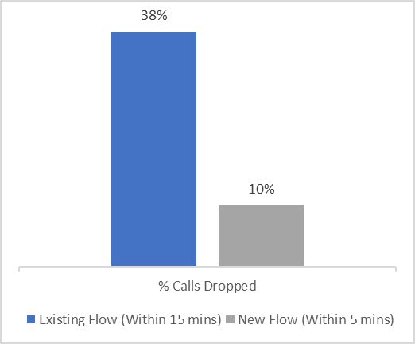
Early detection of Non-SPAM caller
Real-Time Unblocking Genuine Buyers in 5 mins
Actual Spammer (SPAM)
Permanent Blocked
Buyer trapped in Temporary Blocked Logic
Manual Audit of Call Recordings
Genuine Buyer (Non-SPAM)
Within 15 mins
Unblocked
Within 5 mins
Monthly Increment
Expected Impact
Monthly Increment
PNS Applicable Calls - 20K

Slide 11
Improving Extension Capture(%)
Extension Reverse Lookup Logic
Current(Within 5 mins)
Primary number check between PNS Caller Glid &
C2C Click Glid
Caller enters incomplete PNS Extension Number
Identify Supplier PNS Number(based on caller-supplier activity on IM)
Successful buyer-supplier connect
Additional Proposed Logic(Within 5 mins)
Primary & secondary number check between PNS Caller Glid and C2C Click Glid

Slide 12
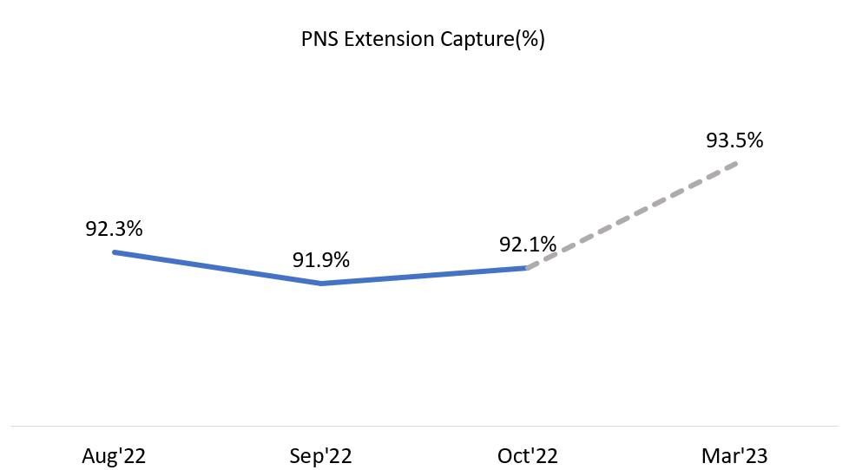
Improving Extension Capture(%)
Expected Impact
PNS Applicable Calls - 10K/Month

Slide 13
Increase PNS Applicable to Success Ratio
OBJECTIVE: Increase Success% from 65% to 68%
1.3%
1%
PNS Number Mapping
Save IndiaMART Buyer Number
Success % is directly proportional to number mapped to PNS
10% increase in Success % from 1 number mapped to 2 numbers mapped & of 5% from 2 numbers mapped to 3 numbers mapped
Target:
Reduce Paid Suppliers with 1 number mapped: 10%
Reduce Paid Suppliers with 2 number mapped: 5%
Paid: Success % of suppliers with buyer number saved is 2% higher
Free: Success % of suppliers with buyer number saved is 15% higher
Target:
Paid suppliers: 5%
Free supplier: 10%

Slide 14
Increase PNS Applicable to Success Ratio
OBJECTIVE: Increase Success% from 65% to 68%
1%
0.3%
RAG Model
Revival of PNS Defaulter
Optimising RAG Model thresholds for free suppliers
Existing RAG Phase 1 Classification thresholds:
i)Green Free Suppliers: >65%
ii)Amber Suppliers: >51% & <65%
iii)Red suppliers: <51%
Increased Success %(Reduced calls to Red suppliers)
Ticketing process on PNS Defaulter
Improve Defaulter Communication
Revive PNS Defaulter by
adding more numbers in PNS
case studies on reasons for not responding
success% wise bucketing of suppliers

Slide 15


Slide 16
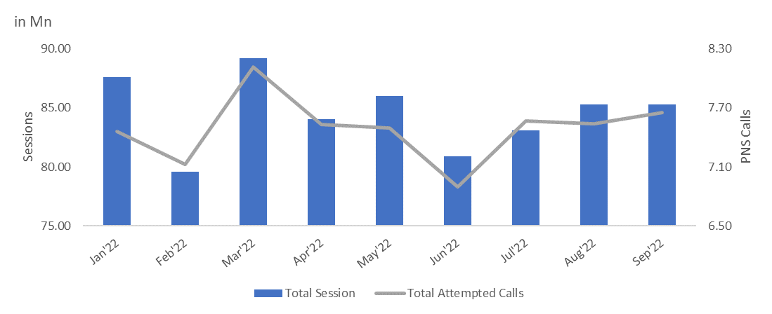
Monthly PNS Attempted Calls
Note: Multiple external factors (change in Google SEO Algo, Returning of 2.2 Knowlarity numbers, Airtel Server crashed) are responsible for dip in Jun’22

Slide 17
Optimising PNS Extension Call Flow
PNS Applicable Calls - 30K/Month
PNS Dropped Calls - 40K/Month

Slide 18
Improve PNS Attempt to Applicable Call Ratio
OBJECTIVE: To increase Attempt to Applicable Call Ratio from 87% to 90%
Enhance Buyer Experience
Remove Live Lead check while transferring calls to LEAP center (~90k calls per month)
Reduce call drop before pre-call API trigger
Optimising Extension Call Flow Logic(~30k calls per month)
Early detection of Non-SPAM caller
By early detection of genuine buyers getting blocked in our SPAM logic, we have increased (~20K calls per month)
Improving Extension Capture(%)
Primary-secondary/Alternate number matchmaking
Sibling-Parent Logic matchmaking

